Slide 1





Global Gender Equality
A comparison study of gender equality and work between a selection of countries in all regions of the world based on employment and world development indicators from the World Bank Datasets

Slide 2
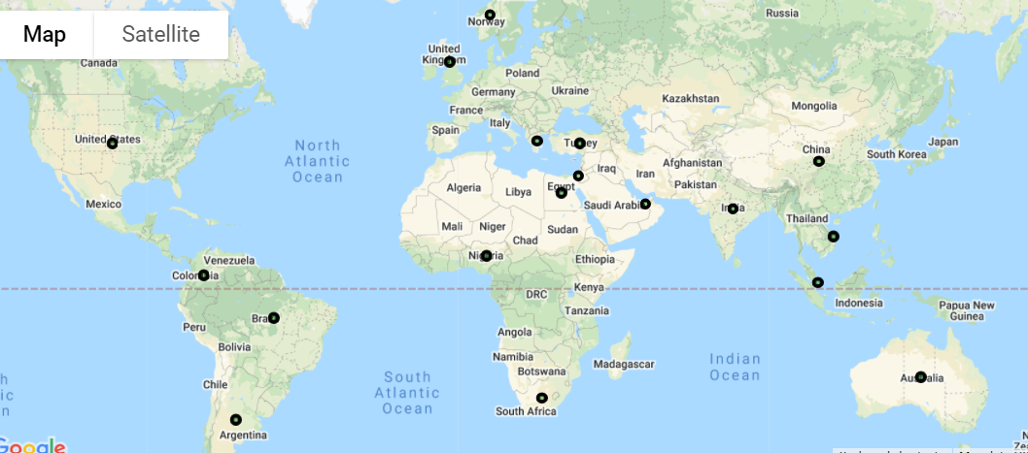
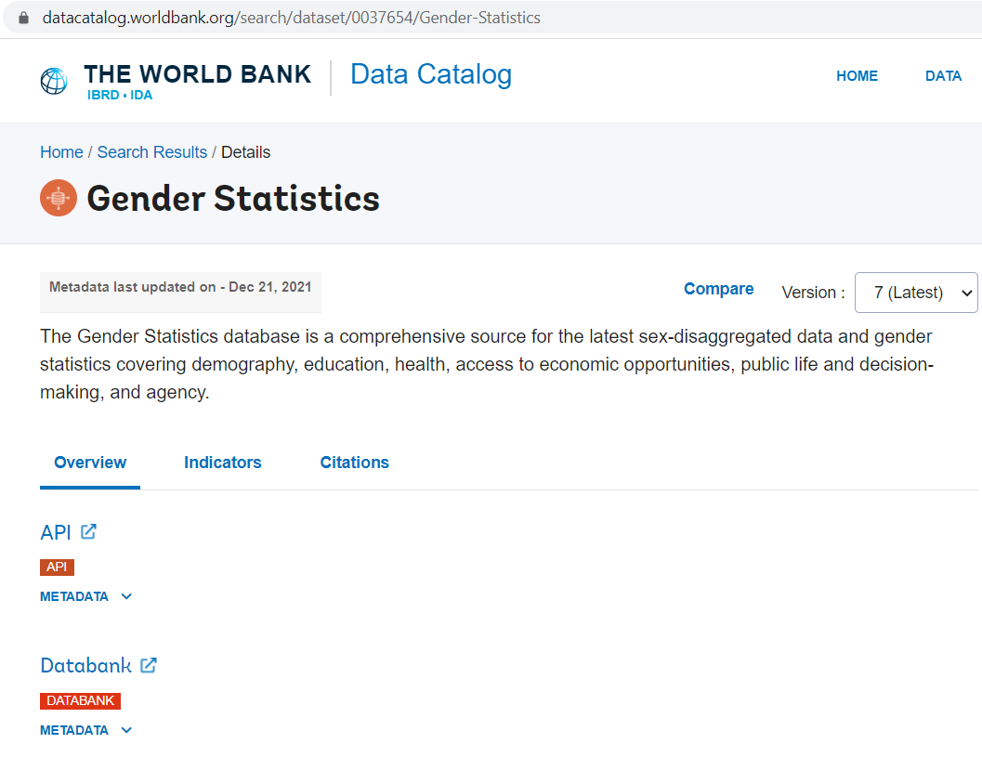
Gender Statistics, The World Bank Source: World Bank Data API
1
2
1. We gathered our research using The World Bank Gender Statistics Data Catalog including 922 indicators on 227 countries dating back to year 1960
We narrowed our scope down to 18 countries representing all continents and the following indicators as reported in 2018:
Labor Force Participation Rates: % of Population Male/Female
Human Capital Index (HCI)
GDP per capita, PPP
Population
Unemployment Rates % of labor force Male/Female

Slide 3
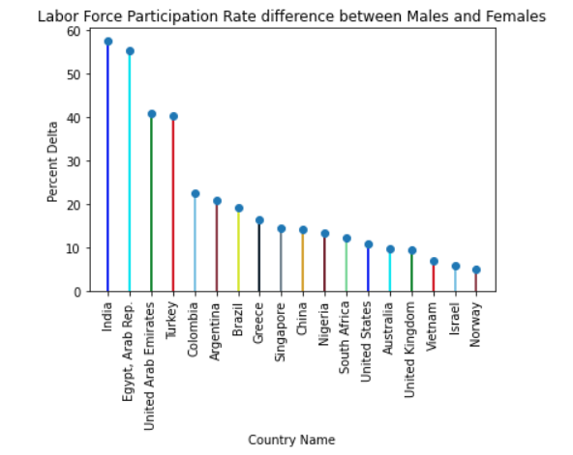
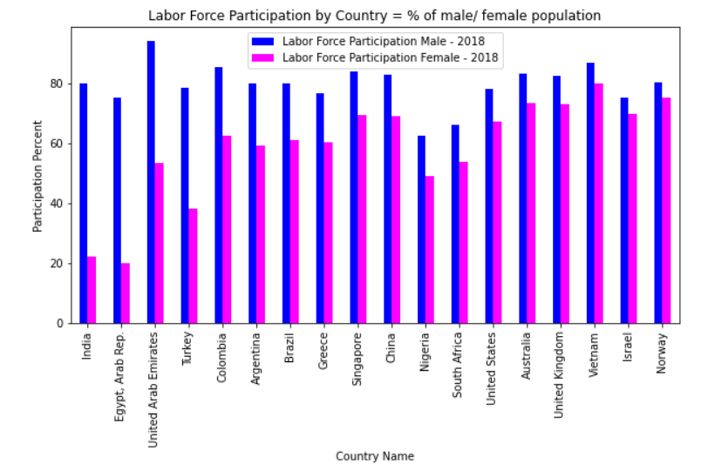
3
Creating attributes based on World Bank Data “Percent Delta” was created to measure Equality between Males and Females in the Work Force
We use the “Percent Delta” attribute to drive correlations to the other attributes within our study. We also created the attribute to easily identify those countries in our study with higher rates of inequality to lower rates of inequality.

Slide 4

4
Human Capital Index (HCI)
Study: The changing nature of work and economic refinement of the world today require societies to understand gender inclusion in human capital measurements.
We assessed quantifiable indicators form the workforce dimension of the index applying the Pearson correlation measure with a coefficient value range from -1 to +1.
Measures
51 indicators in 4 dimensions:
Education
Health and Wellbeing
Workforce and Employment
Enabling Environment
Health
Related to individual’s and societies
current and expected
capacity to: acquire, develop and deploy skills

Slide 5
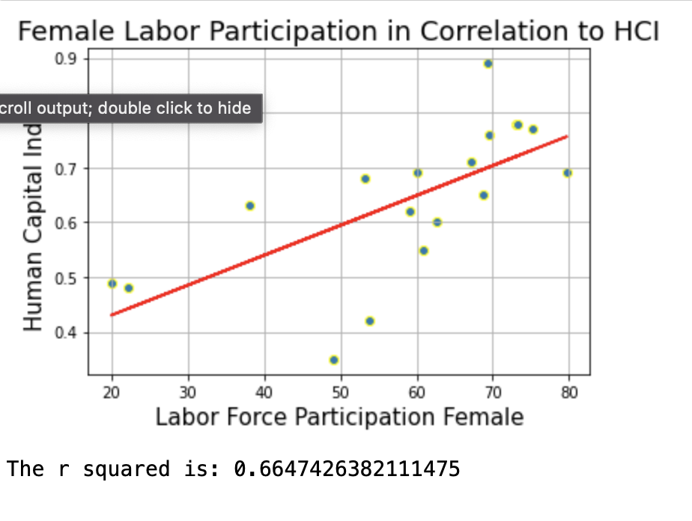
4
Human Capital Index (HCI)
Workforce and Employment
Research questions:
Is female labor participation related to a Human Capital Index (HCI) over 0.5?
We found a positive up hill correlation of 0.66 between female labor participation of women 15 to 64 years of age and HCI.
Further analysis is needed to understand the relationship since the variables may be conditioned by each other but not related. Female labor force participation is measuring economically activity women in 2018 and HCI predicts human capacity.
Health

Slide 6
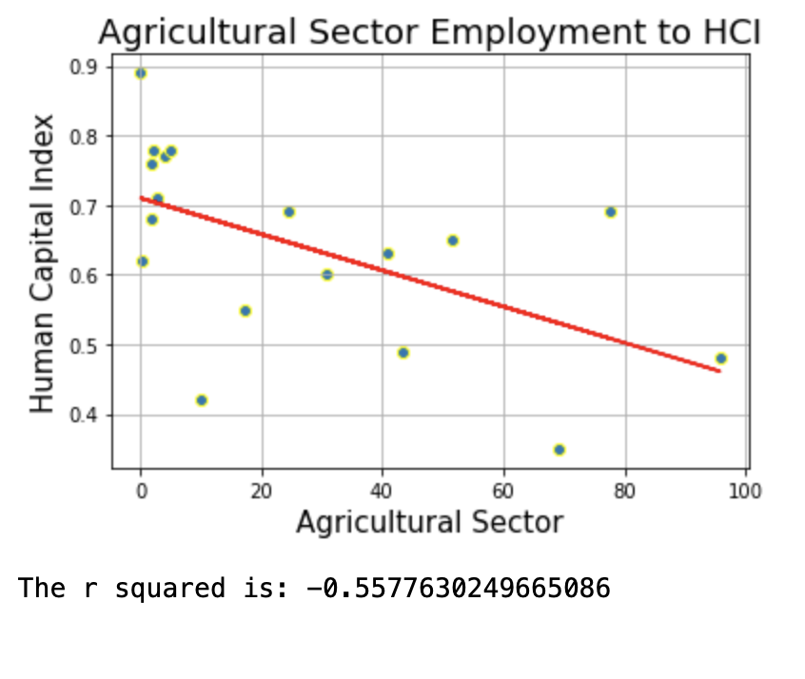
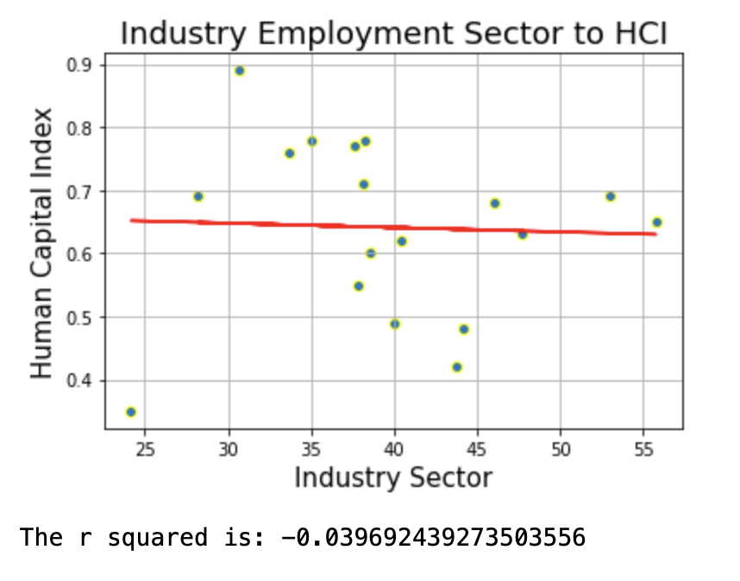
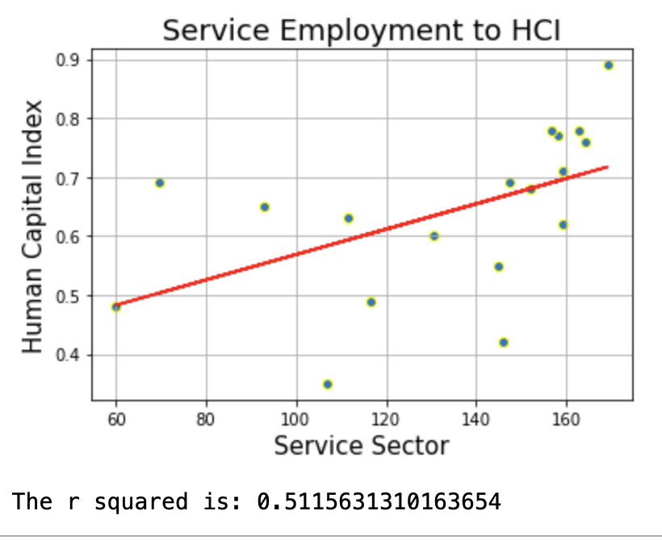
4
Human Capital Index (HCI)
Workforce and Employment
What is impact of labor sectors (agriculture, industry, services) on HCI ?
Research questions:
Health
We found a negative down hill correlation between employment in agriculture and industry sectors in relation to HCI.
Employment in the service sector has a positive up hill correlation of 0.5 to HCI. Illustrating the dynamic nature of the Human Capital Index and how it relates to shifts in economic activities.

Slide 7
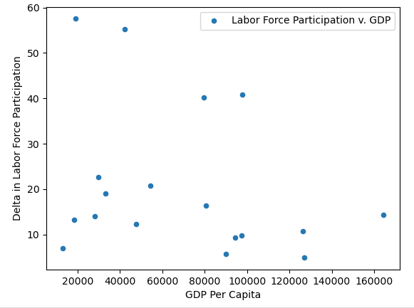
Comparing GDP and labor force participation
5
We sought to discover whether there was a correlation between gender gap in labor force participation and overall economic performance in that country.
We measured the difference between female and male participation rates and GDP per capita based on purchasing power parity.
We found that there was no linear correlation (R Value -0.28) for the countries examined.
We suspect that because only 18 countries were included that our sample size may have been too small and included too many outliers to detect a correlation. (P Value 0.25)

Slide 8
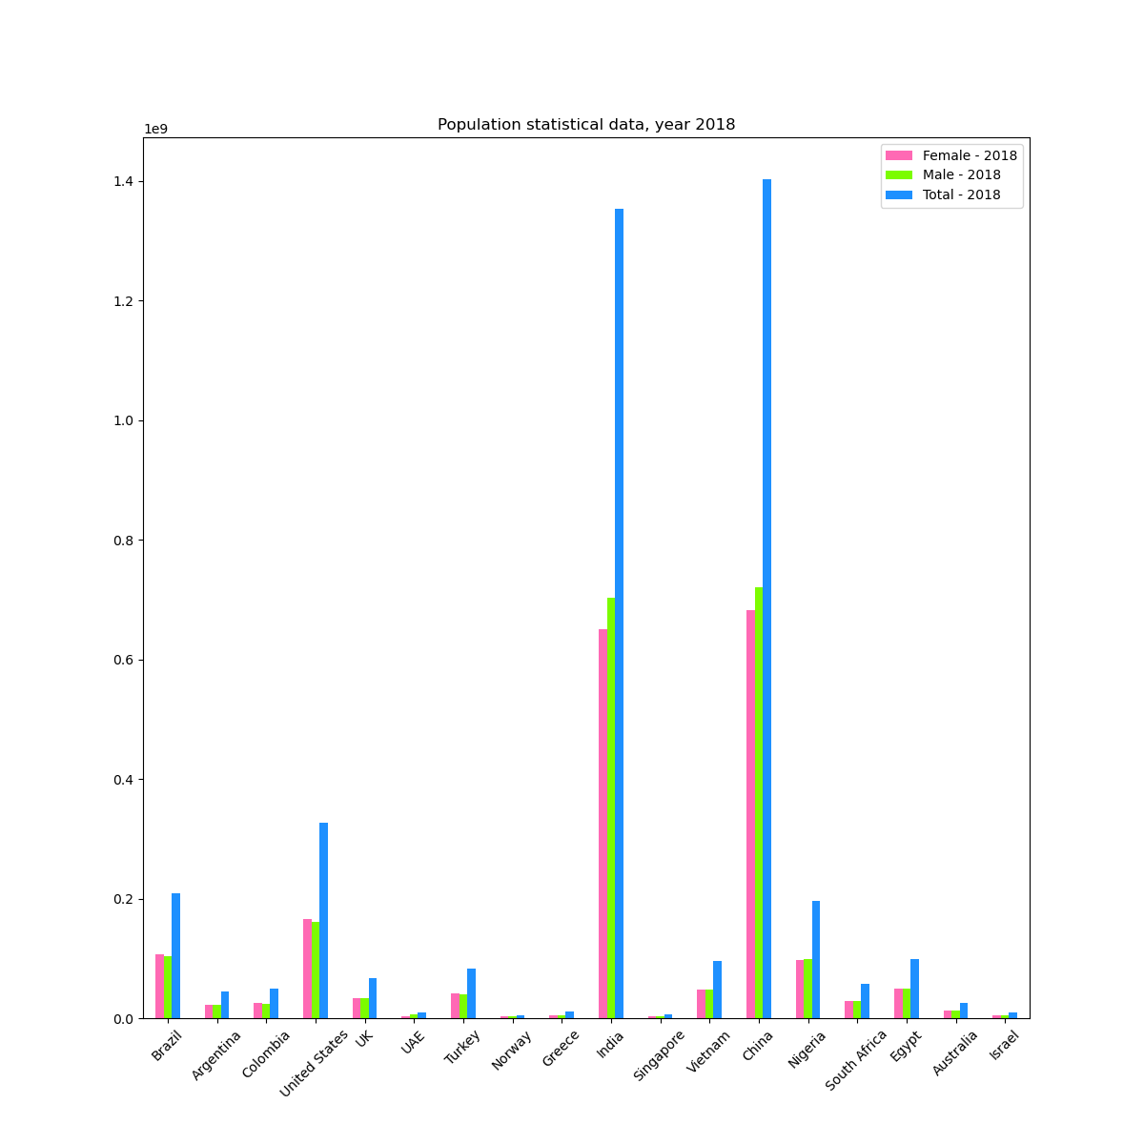
Population statistical data, year 2018
6
The total number of people varies greatly, as expected
However, it is hard to say if the female to male ratio is similar in all these countries

Slide 9
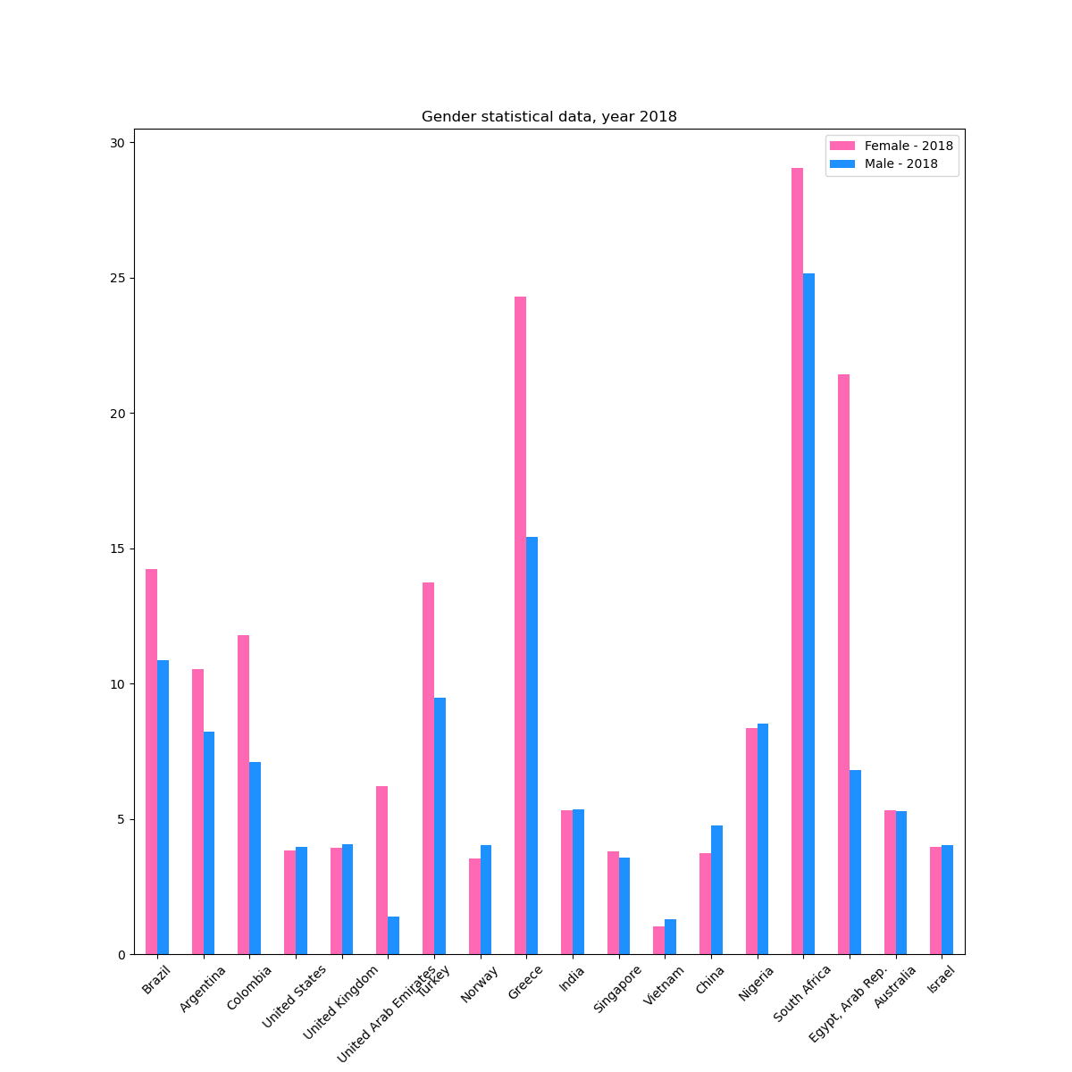
0.9997201070038135
0.9997201070038135
0.9997201070038135
6
Gender statistical data, year 2018
Correlation = 0.99972
It means that female to male ratio is pretty much the same

Slide 10
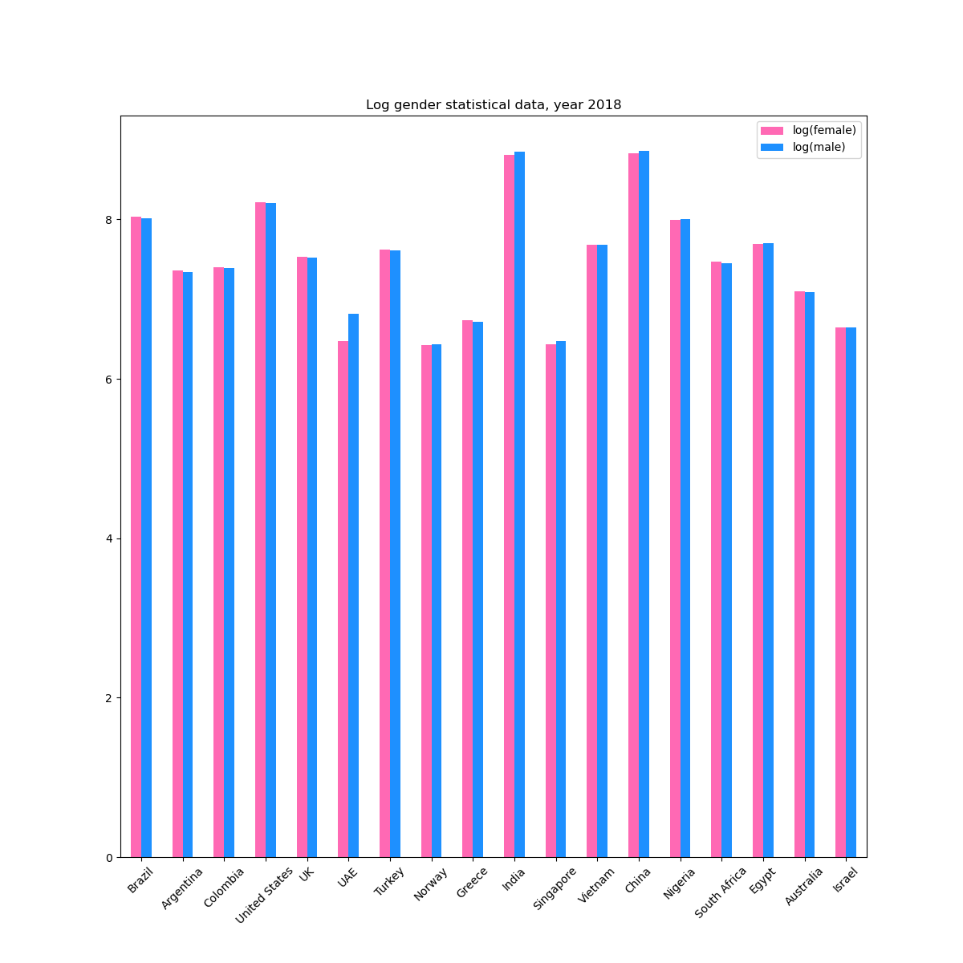
5
Logarithm gender statistical data, year 2018
Correlation = 0.99368
By converting data to logarithm we can demonstrate that female to male ratio is indeed the same.

Slide 11
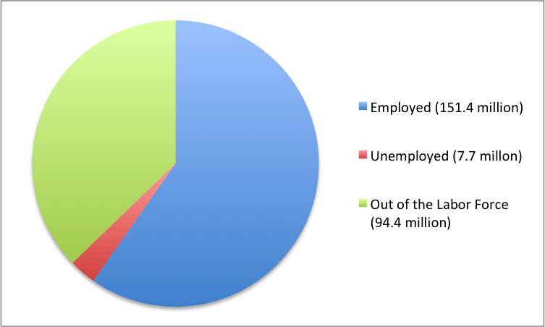
Unemployment Trends around the world
7
Employed, Unemployed, and Out of the Labor Force Distribution of Adult Population (age 16 and older), 2016.
The unemployment rate is calculated by dividing the number of unemployed people by the total number in the labor force, then multiplying by 100

Slide 12
Definition of unemployed
7
United States
“People are classified as unemployed if they do not have a job, have actively looked for work in the prior 4 weeks, and are currently available for work”
“Temporary layed off workers are counted as unemployed whether or not they have engaged in a specific job seeking activity”
Around the World
The International Labor Organization (ILO, 2013:56) defines unemployment as referring to persons of working age (defined as starting age 15 in. Egypt); who are “not in employment”; actively “seek employment”, is “available” for work.

Slide 13
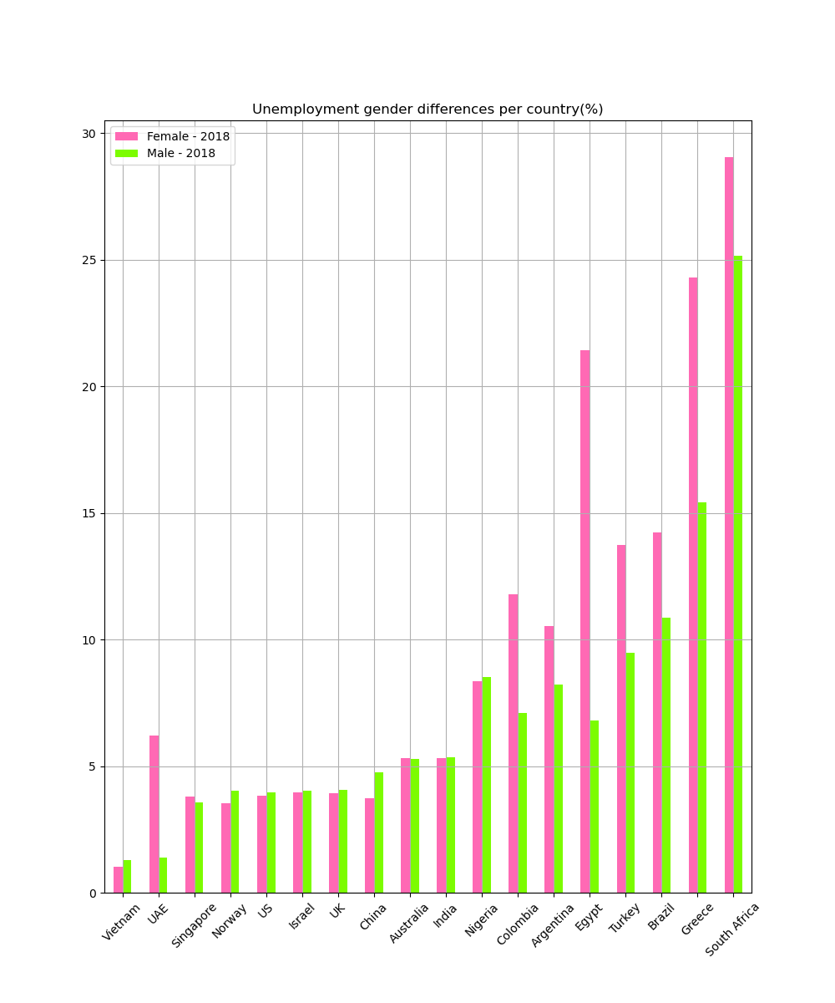
7
Country Name | Female - 2018 | Male - 2018
Vietnam | 1.03 | 1.28
UAE | 6.19 | 1.39
Singapore | 3.79 | 3.55
Norway | 3.54 | 4.03
US | 3.84 | 3.95
Israel | 3.95 | 4.04
UK | 3.94 | 4.05
China | 3.72 | 4.75
Australia | 5.32 | 5.28
India | 5.30 | 5.34
Nigeria | 8.36 | 8.51
Colombia | 11.79 | 7.09
Argentina | 10.54 | 8.23
Egypt | 21.44 | 6.81
Turkey | 13.74 | 9.49
Brazil | 14.23 | 10.87
Greece | 24.29 | 15.41
South Africa | 29.05 | 25.14
Unemployment gender differences per country(%)

Slide 14
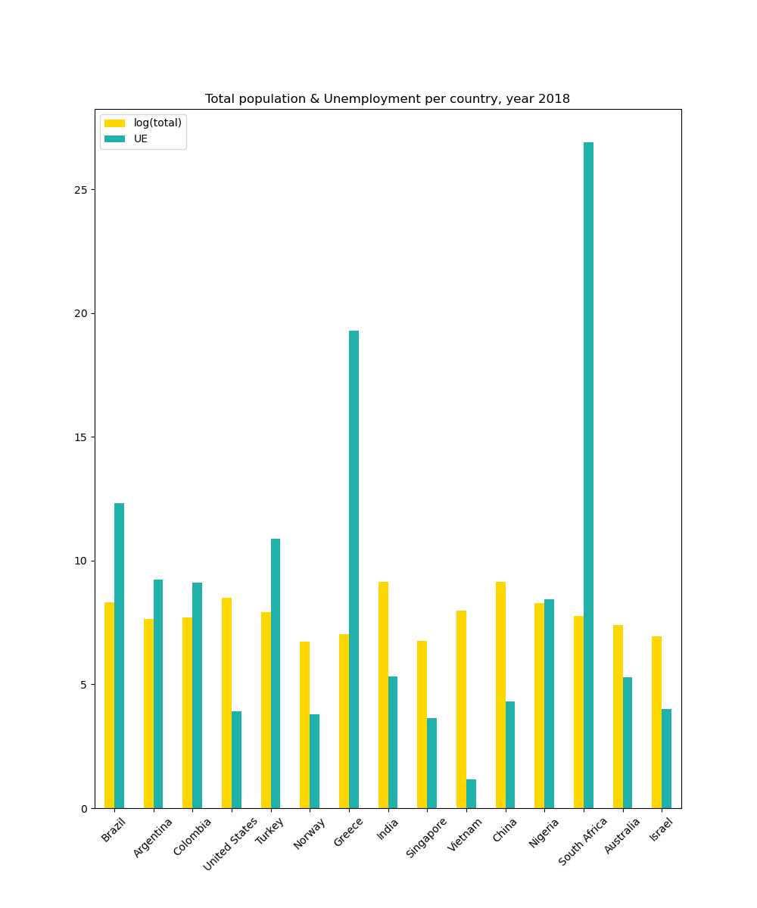
Total population & Unemployment per country, year 2018
-0.08365558045363355
-0.08365558045363355
7
Correlation: -0.08
There is no correlation between population size an unemployment rate

Slide 15

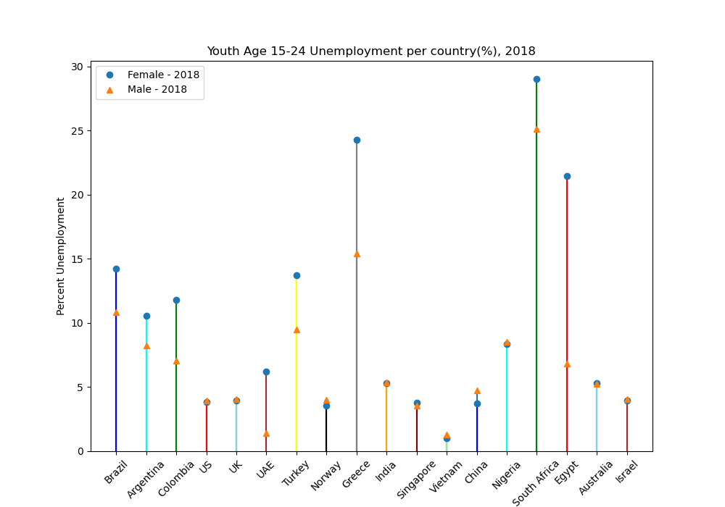
7
It is clear that female and male unemployment rates vary greatly between the countries. that
These data need to be explored further to find out what causes the discrepancies in male and female unemployment rates in each country

Slide 16
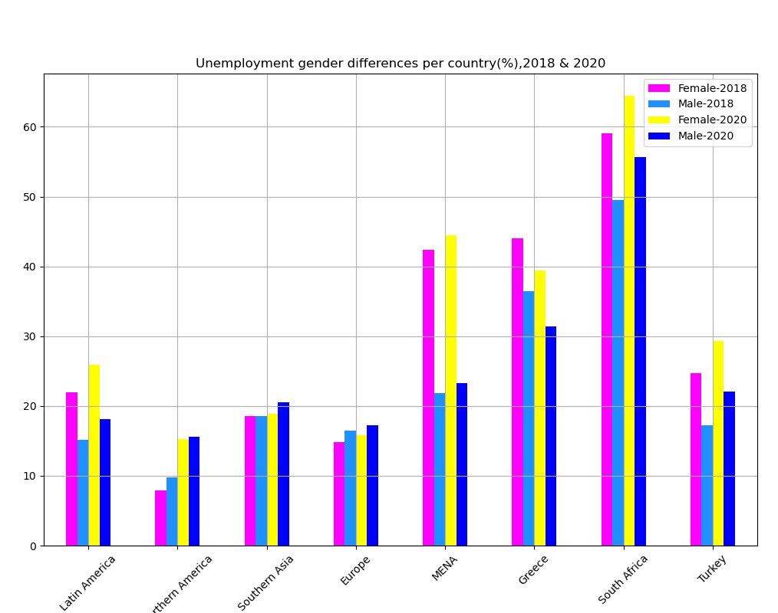
0.977
0.977
7
Unemployment
Percentage Gender
Difference per country,
2020 vs 2018
Correlation between:
Female-2018 and Female-2020 is 0.977
Male-2018 and Male-2020 is 0.962
Female-2018 and Male-2018 is 0.919
Female-2020 and Male-2020 is 0.905

Slide 17

7
Unemployment is on the rise globally, but gender gap is still there despite pandemics
 | Region_Country | Female-2018 | Male-2018 | Female-2020 | Male-2020
0 | Latin America | 21.9 | 15.2 | 25.9 | 18.1
1 | Northern America | 7.9 | 9.8 | 15.3 | 15.6
2 | Southern Asia | 18.6 | 18.6 | 18.9 | 20.5
3 | Europe | 14.8 | 16.5 | 15.8 | 17.2
4 | MENA | 42.4 | 21.8 | 44.5 | 23.3
5 | Greece | 44.0 | 36.4 | 39.4 | 31.4
6 | South Africa | 59.1 | 49.5 | 64.4 | 55.7
7 | Turkey | 24.7 | 17.2 | 29.3 | 22.1

